Slide 1
Conceptualize
How to explore the big ideas and map out your content before you get into the detail.
5C Framework for successful digital learning

Slide 2
Conceptualize:
The second C of the 5C framework
If you’re following the 5C Framework, you should now have a clear understanding of your audience and their needs from the all-important Capture stage. Now, you need a digital learning design that will meet those needs and achieve your objectives. One of the most common questions clients ask at this stage is ‘How?’ What’s the secret to turning raw content into an engaging learning experience?
Experience shows us that starting with the end goal and working backwards from that is key. The Conceptualize Guide will help you and your team turn your needs into a vision for an effective, engaging piece of digital learning one step at a time. Find a couple of hours with your team, jot down your ideas in this guide, grab a notepad and get designing.
Need some support? Find out more about our Learning Consultancy team and our coaching and design services at each stage of the 5Cs Framework.

Slide 3
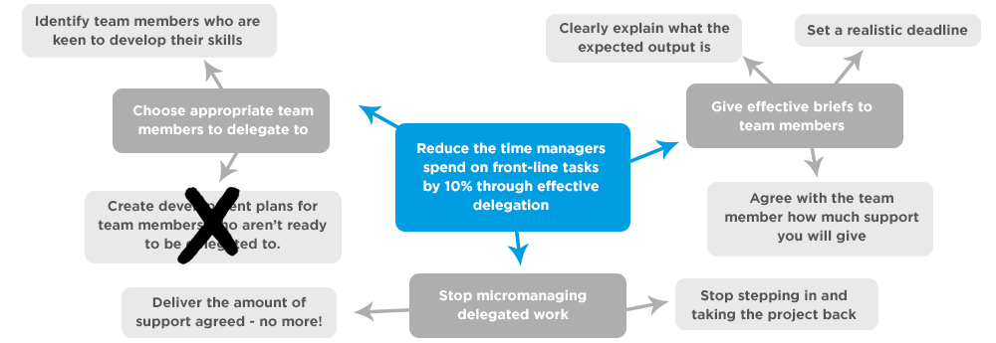
Example: Delegation skills
The trick to creating great elearning is not to start with your content. Instead, start with your goals. Then, when it's time to turn to your content, it's a case of matching the relevant points to your goals.
Take a look at this example of how we tackled a project on delegation skills, starting with the goal in the middle. The next few pages will guide you through creating your own design, step by step, using this as an example.

Slide 4
1
Document your goal
Remind yourself of your goal from the Capture stage; you’ll build the rest of your content map around it. Remember to make your goal as performance-focused and measurable as possible, so you’re clear on the impact you want your elearning to make.
Document your goal here. If you want to create your own mind map, you can also put your goal in the middle of a blank sheet of paper.
In our delegation skills example on slide 2, our goal is to ‘Reduce the time managers spend on front-line tasks by 10% through effective delegation’

Slide 5
2
Translate into actions
Next think about what people need to be able to do in the real world in order to meet that goal. Not what they need to know - we’ll come on to that! - but what do they need to do. Include things they might need to start doing, stop doing or do differently.
Write these actions around your goal to form the start of a mindmap.
You may feel that sub sections of your audience need to do slightly different actions. That’s great - the more personalized your learning is, the better. Highlight audience specific sections in a different colour.
To meet our goal for delegation skills, learners need to:
Choose appropriate team members to delegate to
Give effective briefs to team members
Stop micromanaging delegated work (specific to a subgroup of the audience)

Slide 6
3
Map your content
Now look at each action individually. What do people need to know in order to complete that action?
Write the key learning points that directly support each action.
Got some learning points that don’t fit an action?
Jot them down in this separate box - we’ll revisit them on the next slide.
Actions:
Learning points:
Take a look at our mind map on page 2 to see the learning points that support our actions.

Slide 7
4
Cut it down
Your elearning should be a valuable use of people’s time. So once all your learning points are on the page, revisit each one and question whether you really need it. Keep in mind that our data gathered from millions of learners shows that users start to ‘drop off’ after 15 minutes of elearning.
Start with any learning points in your ‘other’ box. If they don’t map to an action that supports your goal, it’s very unlikely that they’re needed. Then move on to your core learning points. Can each piece of content justify itself?
Keep hold of: | Question whether you need:
Practical tips and advice | Lots of theory
Examples and stories | Non-essential background information
Opportunities to practice and apply
On reflection, we cut out ‘Create development plans for team members who aren’t ready to be delegated to’ as it doesn’t directly support the goal and would be better placed in a different piece of learning.

Slide 8
5
Wrap your key points up in a learning experience
Now comes the fun part - getting creative and brainstorming how your learning points will fit together into a single experience. You might want to grab a notebook to sketch out different structures and flows through your content.
Think about how you will:
Hook your learners in at the start
Personalize the experience so specific audience subgroups get what they need
Maintain attention throughout
Leave your audience with a practical call to action
Going through your key points in a logical order is one way of structuring your content, but bear in mind that depending on your audience and learning points, other experiences can have more impact.
Look at the table over the next few slides for some guidelines and inspiration.

Slide 9
Learning experience | Great for…
Plunging your audience straight into a scenario or practical activity and delivering the learning points as feedback or part of the story. See an example | An audience that likes to ‘have a go’ and learn through doing Learning that requires practise or more than one skill at once - such as sales skills or performance management. Topics that are best explained in a practical context
A menu of short topics that each tackle one learning point. Learners can choose the topics they need. | A varied audience with people who have different needs/levels of prior knowledge Audiences who only have short windows of time to complete learning in Non-linear content
A web-style page of content that learners can scan to find the elements they need | Browsable, scannable content Users who know what they need Just-in-time performance support

Slide 10
Learning experience | Great for…
A learner-focused, reflective experience that helps them understand something about themselves, and offers help See an example | Content that’s not black and white, but is personal Content areas where there’s no ‘right and wrong’ Audiences who would rather figure things out for themselves than be ‘told’ how to do things
An interactive experience that uses incentives such as badges, points, certificates See an example | Audiences that respond well to targets and achievements Subject areas where there’s a ‘right’ or ‘best’ way to do something
With delegation skills, we were dealing with an audience of manager and a topic areas where there’s no single ‘right way’ to delegate. To meet these needs, we chose a reflective experience followed by a practical scenario that provides a chance to practice. Take a look at the end result here.

Slide 11
6
Focus on the nitty gritty
Finally, think about how you can bring each individual learning point to life. Within your overall experience, what’s the best way to communicate a key point in a way your audience will remember?
Use these prompts and the interactions available to you to match an experience to each learning points:
What will help people understand the point? Does it need to be supported with a visual or an example?
Who should the learning point come from? You might be using characters, expert advice, peer viewpoints…
Would your audience learn best through reading/listening/watching, or through doing? If the latter, how can you best simulate the action they need to practice in an elearning environment?
Going through your key points in a logical order is one way of structuring your content, but bear in mind that depending on your audience and learning points, other experiences can have more impact.
Our top tips came from an expert character and we helped learners put these into practice by using a realistic scenario they are likely to experience at work.

Slide 12
Conceptualize
What next?
Get more 5C Framework guides These will help you to generate design concepts, speed up your production process and much more! Discover our coaching and design services Get hands on support and guidance to help you deliver real-life impact from your projects. Talk to us We’d be happy to help with any questions you have about this guide and discuss how we can help you further.
We hope you’ve found this guide useful!
Starting with your goals, not the content will help you to develop winning digital learning concepts. Make sure you get this step sorted before you even touch your authoring tool!
If you’d like one-to-one support from our Learning Consultancy team, please get in touch.

